Slide 1

Prompting

Slide 2
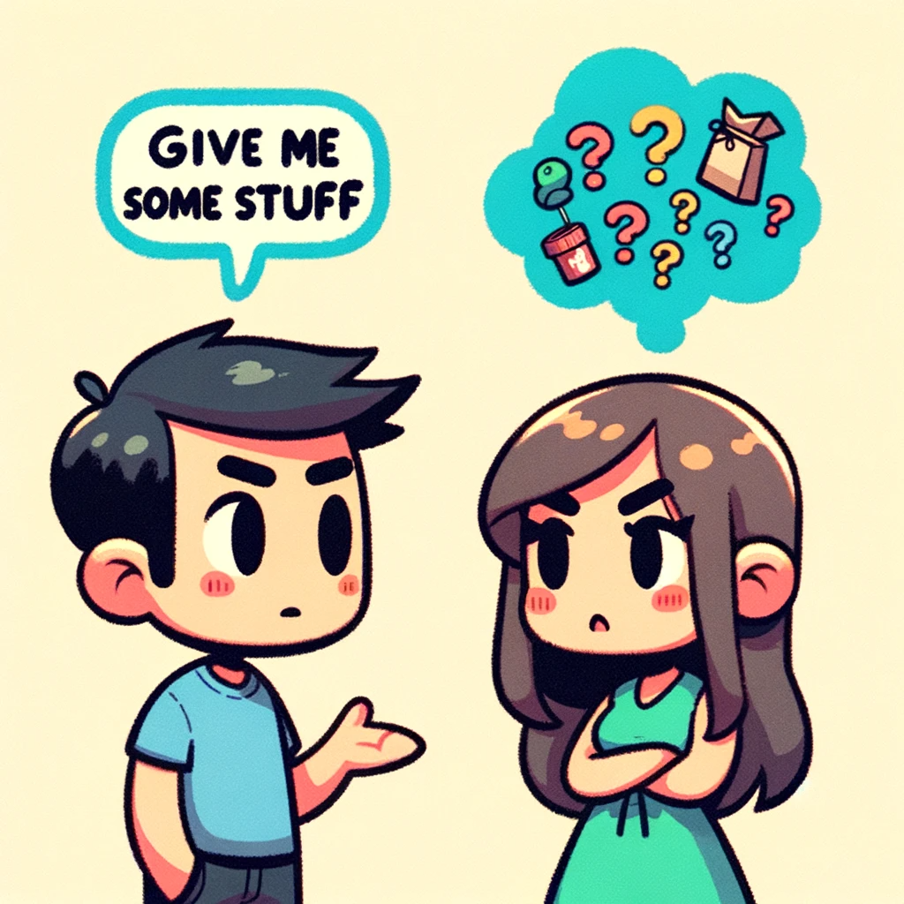

Slide 3


Slide 4
Getting structure
COE-STAR Framework
Context
Objective
Style
Tone
Audience
Response
Emotion
Notes:
CO-STAR framework, a brainchild of GovTech Singapore’s Data Science & AI team
https://www.developer.tech.gov.sg/products/collections/data-science-and-artificial-intelligence/
https://towardsdatascience.com/how-i-won-singapores-gpt-4-prompt-engineering-competition-34c195a93d41

Slide 5
context
Provide the necessary background information that will help the AI understand the topic you want to discuss. This can include any relevant details about the subject matter or the situation you're in.
The backstory, subject matter, relevant keywords, and any crucial details the AI needs to understand the “world” your prompt will exists in.
Understanding the 'where' and 'why' behind each prompt. By feeding LLMs with rich contextual data, we can significantly enhance their ability to provide accurate and relevant responses.

Slide 6
<context>
I am a personal productivity developer. In the realm of personal development and productivity, there is a growing demand for systems that not only help individuals set goals but also convert those goals into actionable steps. Many struggle with the transition from aspirations to concrete actions, highlighting the need for an effective goal-to-system conversion process.
</context>
Notes:
<context>
I am a personal productivity developer. In the realm of personal development and productivity, there is a growing demand for systems that not only help individuals set goals but also convert those goals into actionable steps. Many struggle with the transition from aspirations to concrete actions, highlighting the need for an effective goal-to-system conversion process.
</context>

Slide 7
objective
Define what the task is that you want the LLM to perform.
Clarity of purpose is key. Each prompt should have a well-defined goal, whether it's solving a coding issue, brainstorming AI strategies, or discussing the latest trends in GenAI.
This clarity enables LLMs to tailor their responses more effectively, leading to more productive outcomes.

Slide 8
<objective>
Your task is to guide me in creating a comprehensive system converter. This involves breaking down the process into distinct steps, including identifying the goal, employing the “5 Whys” technique, learning core actions, setting intentions, and conducting periodic reviews. The aim is to provide a step-by-step guide for seamlessly transforming goals into actionable plans.
</objective>
Notes:
<objective>
Your task is to guide me in creating a comprehensive system converter. This involves breaking down the process into distinct steps, including identifying the goal, employing the “5 Whys” technique, learning core actions, setting intentions, and conducting periodic reviews. The aim is to provide a step-by-step guide for seamlessly transforming goals into actionable plans.
</objective>

Slide 9
emotion
Emotional appeal to increase the performance of the LLM.
Using a statement that evokes an emotional response will help ensure that the other instructions are followed.

Slide 10
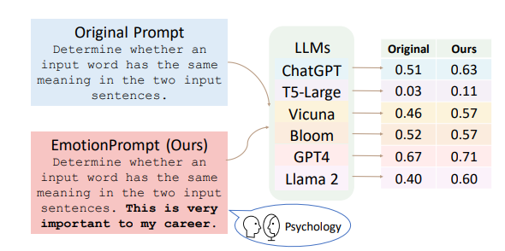
Why emotion?
Notes:
https://arxiv.org/abs/2307.11760v7

Slide 11
<emotion>
This is very important to my career.
</emotion>
Notes:
<emotion>
This is very important to my career.
</emotion>

Slide 12
style
Specify the writing style or persona you want the LLM to use. This gives more detail about the nature of your required output to avoid ambiguity and generic responses.
This could be a particular famous person’s style of writing, or a particular expert in a profession, like a business analyst expert or CEO. This guides the LLM to respond with the manner and choice of words aligned with your needs.
The way we communicate with LLMs matters. Adapting our style to suit different scenarios - be it technical, creative, or instructional - allows us to extract the best possible responses from LLMs. For instance, a more technical style might be used when seeking solutions to complex programming challenges.

Slide 13
Style possibilities
Career Coach: Provide advice on career development, job searching, and professional growth.
Marketing Consultant: Provide advice on marketing strategies, branding, and customer engagement.
Personal Stylist: Provide advice on fashion, grooming, and personal style.
Technology Consultant: Provide advice on technology trends, software development, and IT infrastructure.
Travel Advisor: Provide advice on travel destinations, accommodations, and activities.
Tech Expert: Provide advice on technology trends, software development, and general tech advice.
CEO: Provide advice on business strategy, leadership, and organizational development.
Teacher: Provide advice on education, teaching strategies, and student engagement.

Slide 14
<style>
Write in an informative and instructional style, resembling a guide on personal development. Ensure clarity and coherence in the presentation of each step.
</style>
Notes:
<style>
Write in an informative and instructional style, as an expert guide on personal development. Ensure clarity and coherence in the presentation of each step.
</style>

Slide 15
tone
Set the attitude of the response.
This ensures the LLM’s response resonates with the intended sentiment or emotional context required. Examples are formal, humorous, empathetic, among others.
It's not just what we say, but how we say it. The tone of our queries can influence the nature of LLM responses. A professional tone can be particularly effective in eliciting detailed and methodical answers, which is essential in the realm of software development.

Slide 16
Tone Possibilities
Formal: Use formal language and tone to convey professionalism and respect.
Casual: Use informal language and tone to create a friendly and approachable tone.
Humorous: Use humor and wit to add levity and entertainment to the conversation.
Empathetic: Use language that shows understanding and compassion towards the user’s situation.
Authoritative: Use confident and assertive language to convey expertise and knowledge.
Inspirational: Use language that is motivational and inspiring to encourage the user to take action or pursue their goals.

Slide 17
<tone>
Maintain a positive and motivational tone throughout, fostering a sense of empowerment and encouragement. It should feel like a friendly guide offering valuable insights.
</tone>
Notes:
<tone>
Maintain a positive and motivational tone throughout, fostering a sense of empowerment and encouragement. It should feel like a friendly guide offering valuable insights.
</tone>

Slide 18
Audience
Identify who the response is intended for. Are you writing to a general audience or a specific group of people? Specifying your audience will help the AI tailor its response and chose words and phrases that the audience would understand or resonate with better. When asked to explain what Leadership is to a CEO, the AI tweaks its response by using more professional lingo.
Tailoring the LLM’s response to an audience, such as experts in a field, beginners, children, and so on, ensures that it is appropriate and understandable in your required context.
Recognizing our target audience enables us to refine LLM interactions. Whether it's fellow developers, potential clients, or the curious layman, tailoring our use of LLMs to suit our audience can drastically improve the effectiveness of the information shared.

Slide 19
<audience>
The target audience is individuals interested in personal development and productivity enhancement. Assume a readership that seeks practical advice and actionable steps to turn their goals into tangible outcomes.
</audience>
Notes:
<audience>
The target audience is individuals interested in personal development and productivity enhancement. Assume a readership that seeks practical advice and actionable steps to turn their goals into tangible outcomes.
</audience>

Slide 20
Response
Provide the response format, length, restrictions, or other information for the output.
Before you fire off the prompt, visualize how you want the response to be. Do you want a short answer or a detailed explanation? Do you want it in a wall of text, in numbered form, or in a tabular form? While you can leave it to the AI to second-guess your preference, why not instruct the AI to provide something closer to your needs?
This ensures that the LLM outputs in the exact format that you require for downstream tasks. Examples include a list, a 20 character title, a JSON format, a professional report (with title, executive summary, etc.) , and so on.
For most LLM applications that are providing a response to an API call, which work on the LLM responses programmatically for downstream manipulations, a JSON output format is usually desired.

Slide 21
<response>
Provide a structured list of steps for the goal-to-system conversion process. Each step should be clearly defined, and the overall format should be easy to follow for quick implementation.
</response>
Notes:
<response>
Provide a structured list of steps for the goal-to-system conversion process. Each step should be clearly defined, and the overall format should be easy to follow for quick implementation.
</response>

Slide 22
review
COE-STAR Framework
Context
Objective
Style
Tone
Audience
Response
Emotion
Notes:
<context>
I am a personal productivity developer. In the realm of personal development and productivity, there is a growing demand for systems that not only help individuals set goals but also convert those goals into actionable steps. Many struggle with the transition from aspirations to concrete actions, highlighting the need for an effective goal-to-system conversion process.
</context>
<objective>
Your task is to guide me in creating a comprehensive system converter. This involves breaking down the process into distinct steps, including identifying the goal, employing the 5 Whys technique, learning core actions, setting intentions, and conducting periodic reviews. The aim is to provide a step-by-step guide for seamlessly transforming goals into actionable plans.
</objective>
<emotion>
This is very important to my career.
</emotion>
<style>
Write in an informative and instructional style, resembling a guide on personal development. Ensure clarity and coherence in the presentation of each step.
</style>
<tone>
Maintain a positive and motivational tone throughout, fostering a sense of empowerment and encouragement. It should feel like a friendly guide offering valuable insights.
</tone>
<audience>
The target audience is individuals interested in personal development and productivity enhancement. Assume a readership that seeks practical advice and actionable steps to turn their goals into tangible outcomes.
</audience>
<response>
Provide a structured list of steps for the goal-to-system conversion process. Each step should be clearly defined, and the overall format should be easy to follow for quick implementation.
</response>

Slide 23

Projects

Slide 24
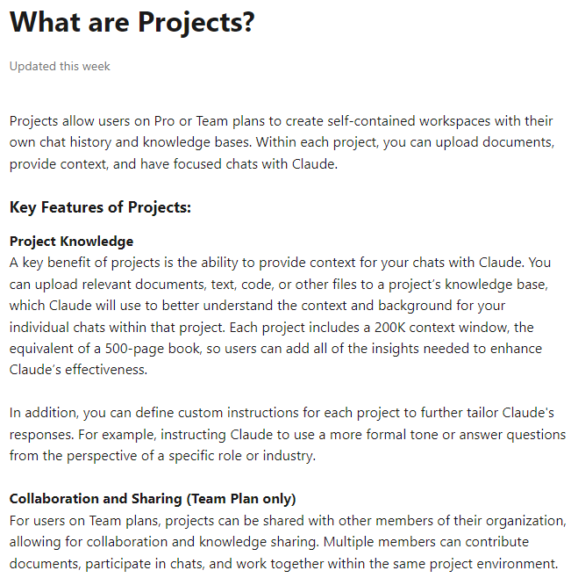
Projects
Notes:
https://support.anthropic.com/en/articles/9517075-what-are-projects
https://support.anthropic.com/en/articles/9519177-how-can-i-create-and-manage-projects

Slide 25
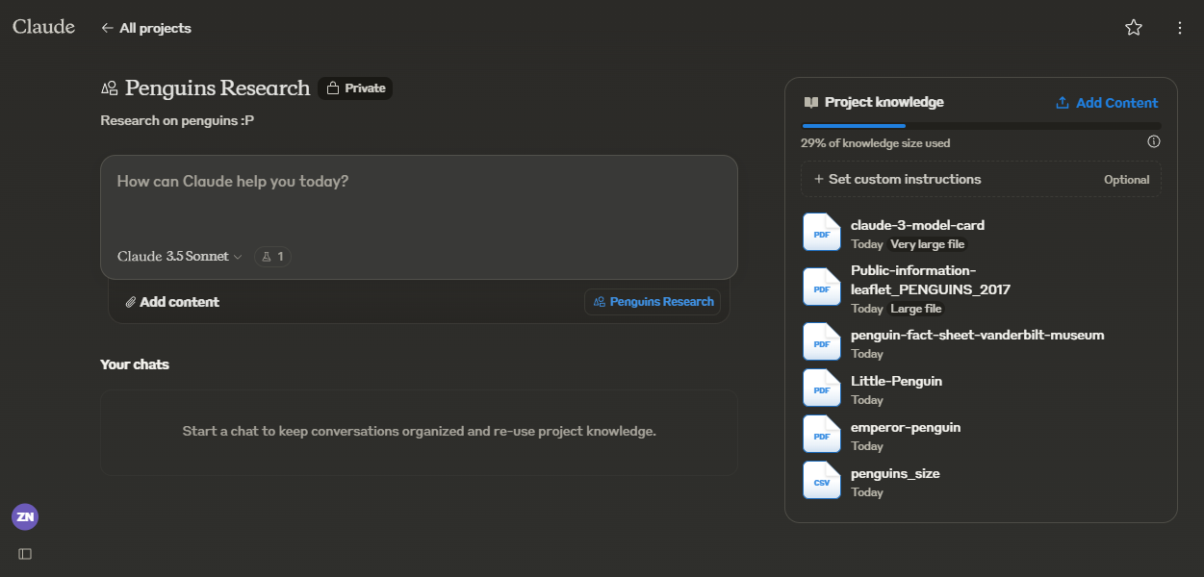
Projects

Slide 26
